Slide 1
HDP Set Construction
(Square)
2019. 11. 07
Solution Service Innovation Group
mail platform

Slide 2
prework
Change hostname and modify hosts file (FQDN)
set up passwordless ssh, iptalbes
ntpd, setenforce
umask check
Repository Configuration
Configuring an external repository
Installing Ambari
Installing HDP
Work after installation
Namenode HA
S-core Coprocessor and HGS distribution
Setting Hbase Config
Hbase restart / HGS operation
Generation and Setting of Hbase Table

Slide 3
Ⅰ. prework
- HDP 3.1 installation was written with reference to Horton Works install guide (2019.05.28)
For additional information other than this ppt, refer to the following URL.
https://docs.cloudera.com/HDPDocuments/HDP3/HDP-3.1.0/index.html => Click Installation > Apache Ambari Installation in the URL above (URL below)
https://docs.cloudera.com/HDPDocuments/Ambari-2.7.3.0/bk_ambari-installation/content/ch_Getting_Ready.html
The HDP installation uses the root account.
HDP 3.1 can be installed in OS rhel7 / jdk 1.8 or more environments.
Recommended OS parameters exist when installing HDP,
In general, the infra personnel automatically set up the server when it is created.
Ssh communication between HDP cluster nodes is required
Register all node information in / etc / hosts.allow, / etc / hosts of all nodes (request center)
source | target | port | usage
operator pc | ALL | 22 | server connection
operator pc | thrift server - tf | 9095 | thrift daemon ui
operator pc | namenode server - nn | 50070 | namenode ui
operator pc | master node server - mn | 16010 | master node ui
operator pc | ambari server - mo | 8080 | Ambari web connection
operator pc | job history server - mo | 19888 | jobhistory
operator pc | Resource manager server - mo | 8088 | resource manager ui
operator pc | datanode server - sn | 50075 | datanode ui
operator pc | datanode server - sn | 8042 | mr job log
operator pc | regionserver server - sn | 16030 | region server ui
operator pc | ambari server - mo | 3000 | grafana ui
operator pc | ambari server - mo | 61888 | ambari logsearch ui
- The right table is the firewall port that should be opened in operator pc. If you can not connect from Windows server, you need to request confirmation from AWS representative (Kang Jin-soo Pro)

Slide 4
Ⅰ. prework
Check hostname and modify hosts file (set FQDN)
Check hostname
# Check if hostname is FQDN type
[root@h.102s.samsung.com ~]hostname
h.102s.samsung.com
# If it is not FQDN type, request change to TA and center representative
# Request to change from Square stage / operation (the development environment is just built as an instance name)
[epsvc@sp_sq_dev_an2_me_hdp_01 ~]hostname
ip-10-4-61-31.ap-northeast-2.compute.internal
Modified hosts file
Check if the # / etc / hosts file contains the node information to be configured in the HDP cluster (including itself).
[epsvc@sp_sq_dev_an2_me_hdp_01 /etc/yum.repos.d]more /etc/hosts
127.0.0.1 localhost localhost.localdomain localhost4 localhost4.localdomain4
::1 localhost localhost.localdomain localhost6 localhost6.localdomain6
10.4.61.31 ip-10-4-61-31.ap-northeast-2.compute.internal
# If not, register with root account
Notes:
When building Square development environment, hostname was built without changing it.
[epsvc@sp_sq_dev_an2_me_hdp_01 /etc/yum.repos.d]hostname
ip-10-4-61-31.ap-northeast-2.compute.internal

Slide 5
Ⅰ. prework
Set Up Password-less SSH setting and iptable release
Password-less SSH
# When constructing an HDP cluster using Ambari, it is necessary to set password-less ssh for inter-node communication within the cluster.
The following operation is performed on the server where Ambari is installed.
Creating ssh key (Enter and enter after entering ssh-keygen)
[root@sp_sq_dev_an2_me_hdp_01 ~] ssh-keygen
Generating public/private rsa key pair.
Enter file in which to save the key (/root/.ssh/id_rsa):
Enter passphrase (empty for no passphrase):
Enter same passphrase again:
[root@sp_sq_dev_an2_me_hdp_01 ~] cat .ssh/id_rsa
2) Ssh public key distributed to each node (distributed to all nodes including yourself)
[root@sp_sq_dev_an2_me_hdp_01 ~] ssh-copy-id ip-10-4-61-31.ap-northeast-2.compute.internal ( 단일노드 )
[root@mo1.101y.samsung.com ~] ssh-copy-id mo1.101y.samsung.com ( 멀티노드 )
[root@mo1.101y.samsung.com ~] ssh-copy-id mn1.101y.samsung.com ( 멀티노드 )
… (Multinode)
ipset
# Check iptable configuration (OK if inactive when executing the following command)
[root@sp_sq_dev_an2_me_hdp_01 ~] service firewalld status
# If it is not inactive
service firewalld stop

Slide 6
Ⅰ. prework
Configure ntpd and SELinux
ntpd configuration
# Check ntpd service operation (service ntpd status)
[root@sp_sq_dev_an2_me_hdp_01 ~] service ntpd status
Redirecting to /bin/systemctl status ntpd.service
● ntpd.service - Network Time Service
Loaded: loaded (/usr/lib/systemd/system/ntpd.service; disabled; vendor preset: disabled)
Active: active (running) since Tue 2019-05-28 06:56:13 GMT; 3s ago
Process: 11537 ExecStart=/usr/sbin/ntpd -u ntp:ntp $OPTIONS (code=exited, status=0/SUCCESS)
Main PID: 11538 (ntpd)
CGroup: /system.slice/ntpd.service
└─11538 /usr/sbin/ntpd -u ntp:ntp -x -u ntp:ntp -p /var/run/ntpd.pid -g
# If it is not active (running), perform service ntpd start.
set-up deactivation
# sestatus | grep SEL (check first)
SELinux status: disabled
# (If the above result is not disabled) perform setsett0

Slide 7
Ⅰ. prework
umask check
Check UMASK
# (Check current status)
[root@sp_sq_dev_an2_me_hdp_01 ~] umask
0022
# If the above result value is not 0022, request change to center

Slide 8
Ⅱ. Repository Configuration
Creating external repository setup & ambari.repo
# External firewall ANY OPEN
# Creating an ambari.repo file with the root account
[root@sp_sq_dev_an2_me_hdp_01 /etc/yum.repos.d]vi ambari.repo
#VERSION_NUMBER=2.7.3.0-139
[ambari-2.7.3.0]
#json.url = http://public-repo-1.hortonworks.com/HDP/hdp_urlinfo.json
name=ambari Version - ambari-2.7.3.0
baseurl=http://public-repo-1.hortonworks.com/ambari/centos7/2.x/updates/2.7.3.0
gpgcheck=1
gpgkey=http://public-repo-1.hortonworks.com/ambari/centos7/2.x/updates/2.7.3.0/RPM-GPG-KEY/RPM-GPG-KEY-Jenkins
enabled=1
priority=1
yum clean all
yum repolist

Slide 9
Ⅲ. Installing ambari
Installing ambari-server
# yum -y install ambari-server
[root@sp_sq_dev_an2_me_hdp_01 ~] yum install ambari-server
Loaded plugins: langpacks, product-id, search-disabled-repos, subscription-manager
This system is not registered with an entitlement server. You can use subscription-manager to register.
Resolving Dependencies
--> Running transaction check
---> Package ambari-server.x86_64 0:2.7.3.0-139 will be installed
--> Finished Dependency Resolution
Dependencies Resolved
====================================================================================================================================================
Package Arch Version Repository Size
====================================================================================================================================================
Installing:
ambari-server x86_64 2.7.3.0-139 Updates-Ambari-2.7.3.0 352 M
Transaction Summary
====================================================================================================================================================
Install 1 Package
Total download size: 352 M
Installed size: 418 M
Is this ok [y/d/N]: y
Downloading packages:
warning: /var/cache/yum/x86_64/7Server/Updates-Ambari-2.7.3.0/packages/ambari-server-2.7.3.0-139.x86_64.rpm: Header V4 RSA/SHA1 Signature, key ID 07513cad: NOKEY
Public key for ambari-server-2.7.3.0-139.x86_64.rpm is not installed
ambari-server-2.7.3.0-139.x86_64.rpm | 352 MB 00:00:04
Retrieving key from http://182.195.49.51/ambari/centos7/2.7.3.0-139/RPM-GPG-KEY/RPM-GPG-KEY-Jenkins
Importing GPG key 0x07513CAD:
Userid : "Jenkins (HDP Builds) <jenkin@hortonworks.com>"
Fingerprint: df52 ed4f 7a3a 5882 c099 4c66 b973 3a7a 0751 3cad
From : http://182.195.49.51/ambari/centos7/2.7.3.0-139/RPM-GPG-KEY/RPM-GPG-KEY-Jenkins
Is this ok [y/N]: y
Running transaction check
Running transaction test
Transaction test succeeded
Running transaction
Installing : ambari-server-2.7.3.0-139.x86_64 1/1
Verifying : ambari-server-2.7.3.0-139.x86_64 1/1
Installed:
ambari-server.x86_64 0:2.7.3.0-139
Complete!
[root@sp_sq_dev_an2_me_hdp_01 ~]
Notes:
/usr/java/jdk1.8.0_141
Validating JDK on Ambari Server...done.
Checking GPL software agreement...
GPL License for LZO: https://www.gnu.org/licenses/old-licenses/gpl-2.0.en.html
Enable Ambari Server to download and install GPL Licensed LZO packages [y/n] (n)? n

Slide 10
Ⅲ. Installing ambari
ambari-server Setup
# ambari-server setup (user input in red, check openjdk installation path in advance)
[root@sp_sq_dev_an2_me_hdp_01 ~] ambari-server setup
Using python /usr/bin/python
Setup ambari-server
Checking SELinux...
SELinux status is 'disabled'
Customize user account for ambari-server daemon [y/n] (n)? n
Adjusting ambari-server permissions and ownership...
Checking firewall status...
Checking JDK...
[1] Oracle JDK 1.8 + Java Cryptography Extension (JCE) Policy Files 8
[2] Custom JDK
==============================================================================
Enter choice (1): 2
WARNING: JDK must be installed on all hosts and JAVA_HOME must be valid on all hosts.
WARNING: JCE Policy files are required for configuring Kerberos security. If you plan to use Kerberos,please make sure JCE Unlimited Strength Jurisdiction Policy Files are valid on all hosts.
Path to JAVA _ HOME: / usr / local / java / jdk8.0.181- > Check that there may be different settings for each server
Validating JDK on Ambari Server...done.
Check JDK version for Ambari Server...
JDK version found: 8
Minimum JDK version is 8 for Ambari. Skipping to setup different JDK for Ambari Server.
Checking GPL software agreement...
GPL License for LZO: https://www.gnu.org/licenses/old-licenses/gpl-2.0.en.html
Enable Ambari Server to download and install GPL Licensed LZO packages [y/n] (n)? n
Completing setup...
Configuring database...
Enter advanced database configuration [y/n] (n)? n
Configuring database...
…
…
…
Ambari Server 'setup' completed successfully.
[root@sp_sq_dev_an2_me_hdp_01 ~]
Notes:
[epsvc@sp_sq_dev_an2_me_hdp_01 /etc/yum.repos.d]echo $JAVA_HOME
/usr/local/java/jdk8.0.181

Slide 11
Ⅲ. Installing ambari
Start ambari-server
# ambari-server start
[root@sp_sq_dev_an2_me_hdp_01 ~] ambari-server start
Using python /usr/bin/python
Starting ambari-server
Ambari Server running with administrator privileges.
Organizing resource files at /var/lib/ambari-server/resources...
Ambari database consistency check started...
Server PID at: /var/run/ambari-server/ambari-server.pid
Server out at: /var/log/ambari-server/ambari-server.out
Server log at: /var/log/ambari-server/ambari-server.log
Waiting for server start.............................
Server started listening on 8080
DB configs consistency check: no errors and warnings were found.
Ambari Server 'start' completed successfully.
[root@sp_sq_dev_an2_me_hdp_01 ~]
Notes:
/usr/java/jdk1.8.0_141
Validating JDK on Ambari Server...done.
Checking GPL software agreement...
GPL License for LZO: https://www.gnu.org/licenses/old-licenses/gpl-2.0.en.html
Enable Ambari Server to download and install GPL Licensed LZO packages [y/n] (n)? n

Slide 12
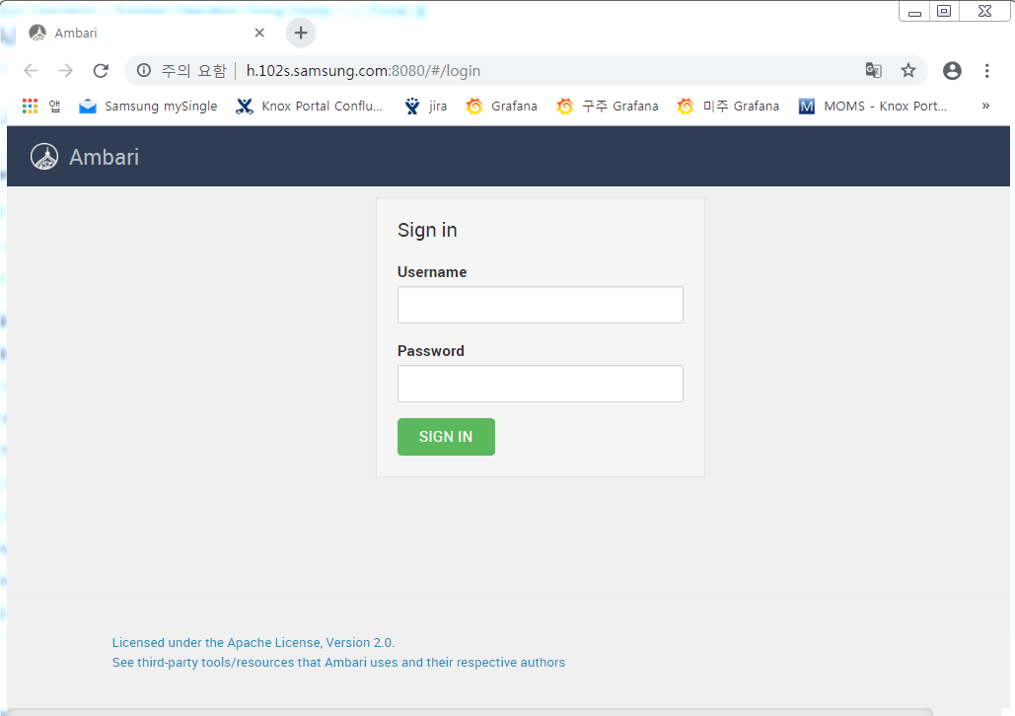
Ⅳ. Installing HDP
Access to ambari web
# Access window server (52.78.176.255: 5389 (epdev / eptest $00) from cmd window to mstsc remote connection)
# http://$HOSTNAME:8080 (admin/admin)
Notes:
Access Windows Server http: / / hdp Instance IP: 8080

Slide 13
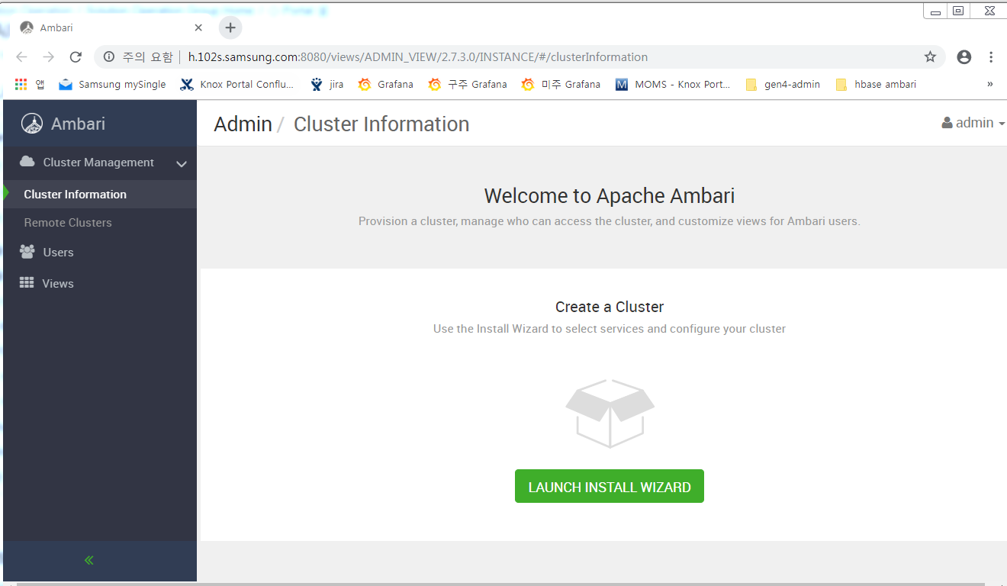
Ⅳ. Installing HDP
Create a Cluster
# Launch Install Wizard

Slide 14
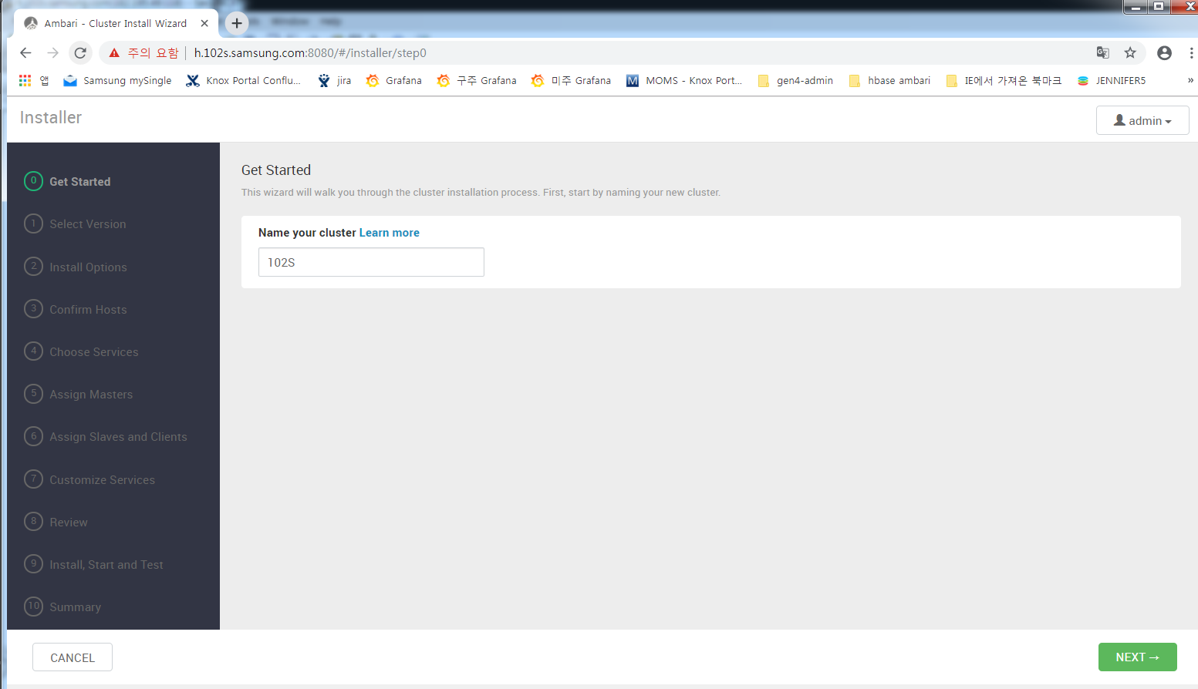
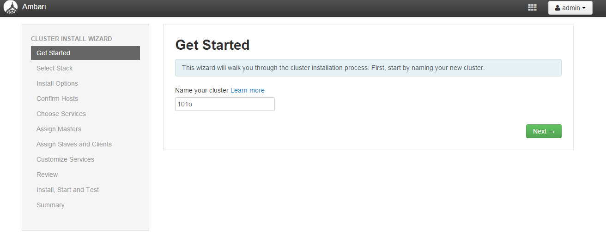
Ⅳ. Installing HDP
Installing HDP
Cluster name setting
101C
Notes:
Build 101C instead of 102S

Slide 15
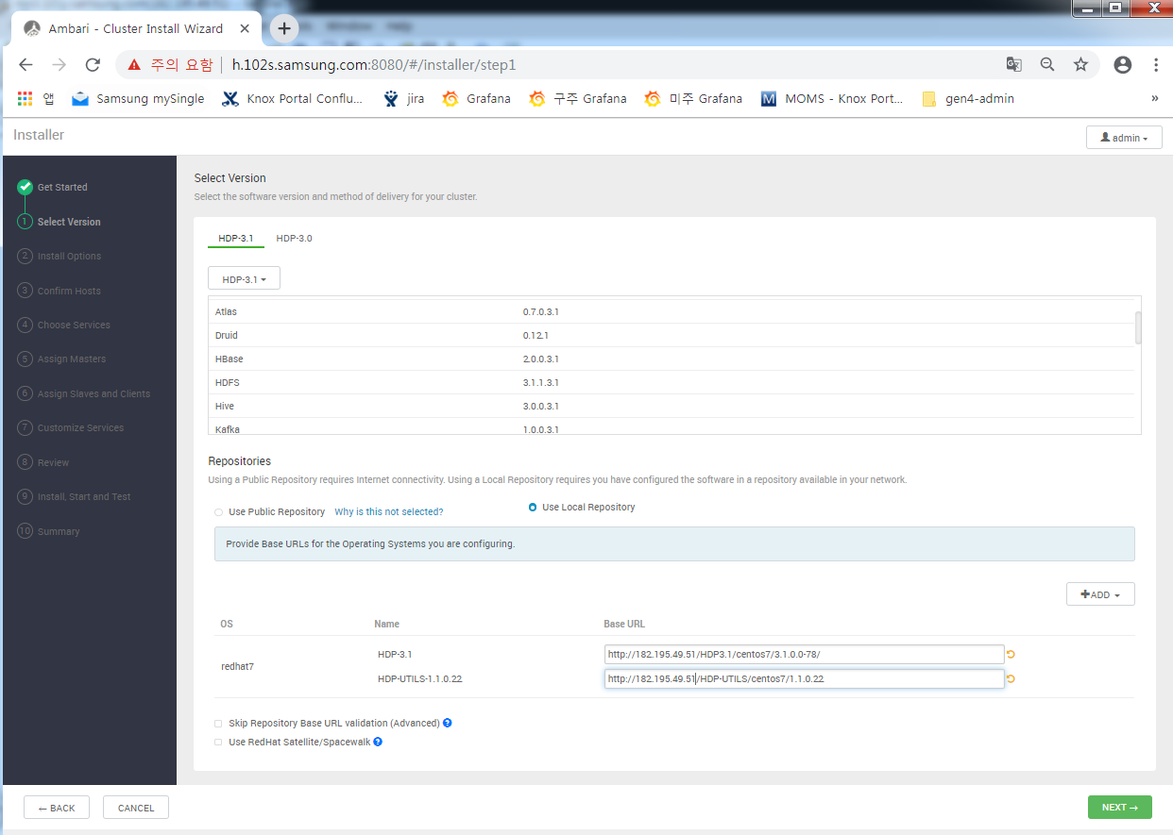
Ⅳ. Installing HDP
Select Stack
# Use Public Repository 선택
Leave only # redhat7 and remove the rest
HDP-3.1 : http://public-repo-1.hortonworks.com/HDP/centos7/3.x/updates/3.1.0.0
HDP-UTIL : http://public-repo-1.hortonworks.com/HDP-UTILS-1.1.0.22/repos/centos7
http://public-repo-1.hortonworks.com/HDP/centos7/3.x/updates/3.1.0.0
http://public-repo-1.hortonworks.com/HDP-UTILS-1.1.0.22/repos/centos7
Notes:
http://h.201s.samsung.com:8080/views/ADMIN_VIEW/2.7.3.0/INSTANCE/#/stackVersions
# # Since the new square portal development environment refers to the external repo
Use Public Repository 선택
Redhat7 left and the rest removed.
Hdp3.1 -> http://public-repo-1.hortonworks.com/HDP/centos7/3.x/updates/3.1.0.0
HDP-UTILS -> http://public-repo-1.hortonworks.com/HDP-UTILS-1.1.0.22/repos/centos7

Slide 16
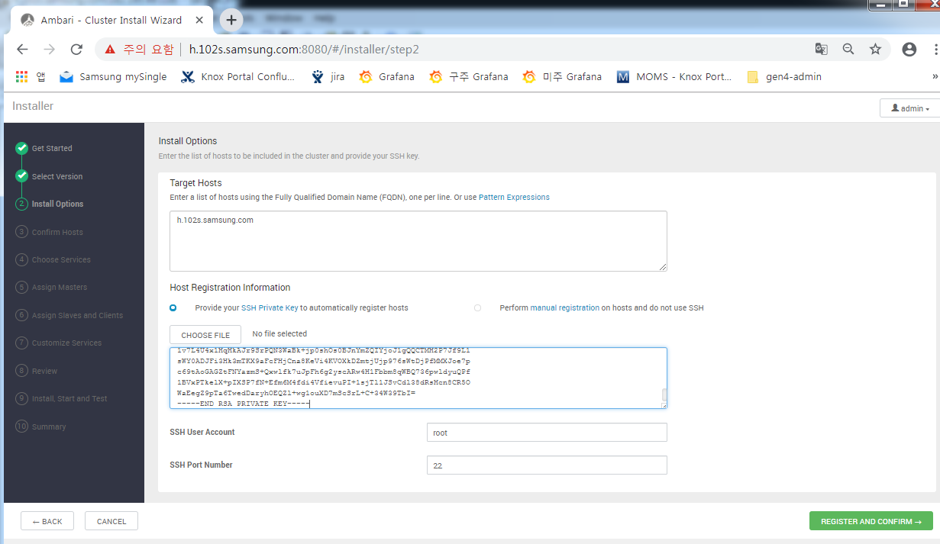
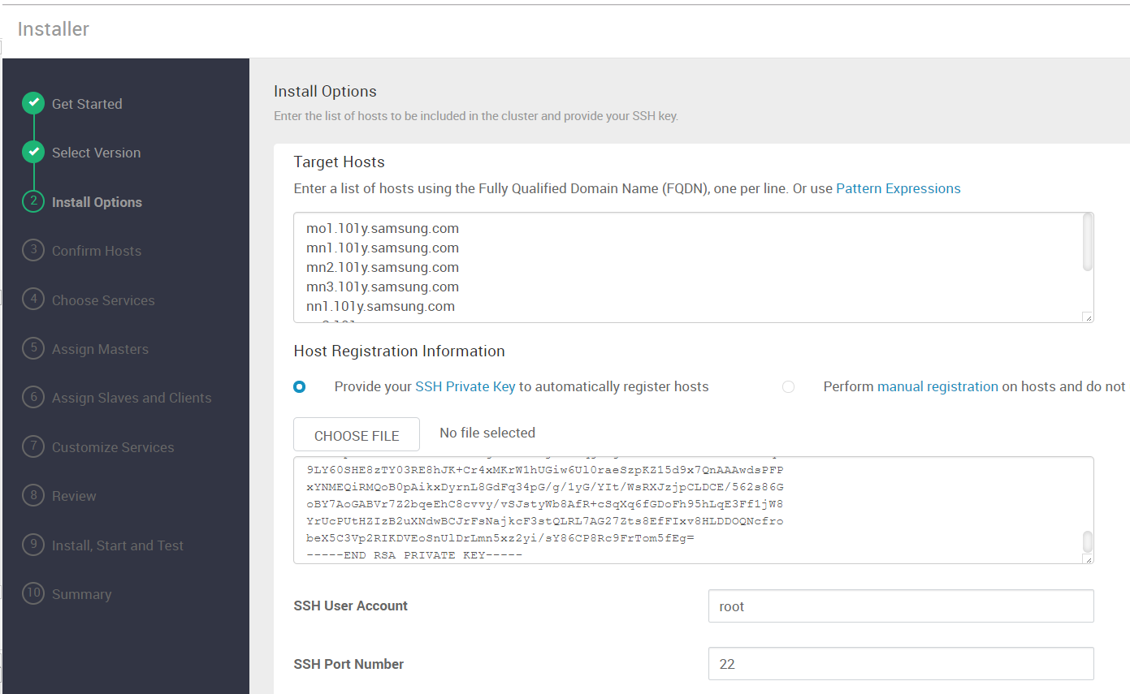
Ⅳ. Installing HDP
Install Options
# Enter the hostname of all nodes that make up the HDP cluster (if it is a single node, it is itself only).
# (Server where Ambari-service is installed) Enter the ssh public key of the root account (cat .ssh / id _ rsa contents)
single node
Multinode (cluster)
ip-10-4-61-31.ap-northeast-2.compute.internal
Notes:
In the case of a new development environment, the hostname is registered as the hostname below because the hostname has not been changed to hdp format.
[epsvc@sp_sq_dev_an2_me_hdp_01 /etc/yum.repos.d]hostname
ip-10-4-61-31.ap-northeast-2.compute.internal

Slide 17
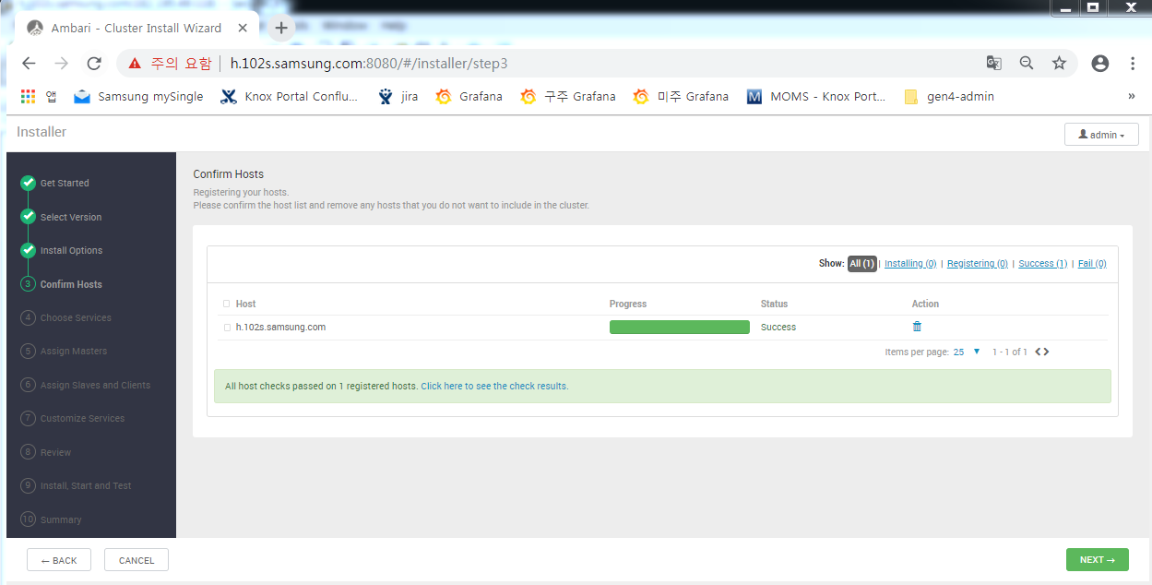
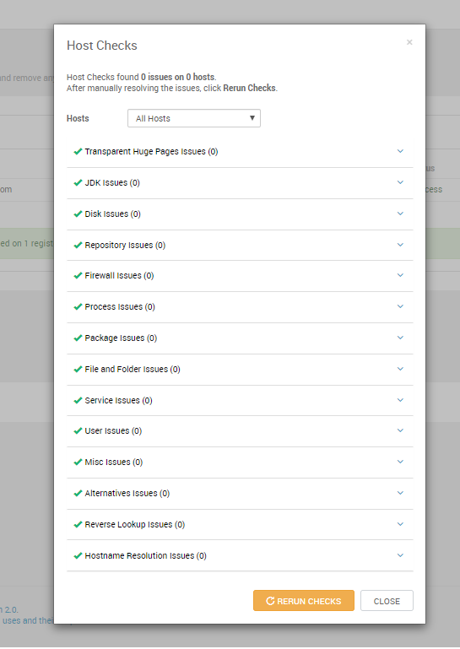
Ⅳ. Installing HDP
Confirm Hosts
# Solve all Potentiol problems (THP, the main problem with existing binaries)
Notes:
[root@s1.101b.ss.com /etc]python /usr/lib/python2.6/site-packages/ambari_agent/HostCleanup.py --silent --skip=users
python: can't open file '/usr/lib/python2.6/site-packages/ambari_agent/HostCleanup.py': [Errno 2] No such file or directory
python /usr/lib/ambari-agent/lib/ambari_agent/HostCleanup.py --silent --skip=users !!!
HostCheckReportFileHandler.py HostCheckReportFileHandler.pyc HostCheckReportFileHandler.pyo HostCleanup.py HostCleanup.pyo
rsoot@s1.101b.ss.com /usr/lib/ambari-agent/lib/ambari_agent]python /usr/lib/ambari-agent/lib/ambari_agent/HostCleanup.py --silent --skip=use
INFO:HostCleanup:
Killing pid's: ['']
INFO:HostCleanup:
Deleting directories: ['']
INFO:HostCleanup:Path doesn't exists:
INFO:HostCleanup:
Deleting additional directories: ['']
INFO:HostCleanup:
Erasing alternatives:{'symlink_list': [''], 'target_list': ['']}
INFO:HostCleanup:Path doesn't exists:
INFO:HostCleanup:Clean-up completed. The output is at /var/lib/ambari-agent/data/hostcleanup.result
[root@s1.101b.ss.com /usr/lib/ambari-agent/lib/ambari_agent]
[root@s1.101b.ss.com /usr/lib]vi /etc/rc.d/rc.local
#!/bin/sh
#
# This script will be executed *after* all the other init scripts.
# You can put your own initialization stuff in here if you don't
# want to do the full Sys V style init stuff.
touch /var/lock/subsys/local
# Disable THP
if [[ -f "/sys/kernel/mm/transparent_hugepage/enabled" ]]; then
echo never > /sys/kernel/mm/transparent_hugepage/enabled
fi
if [[ -f "/sys/kernel/mm/transparent_hugepage/defrag" ]]; then
echo never > /sys/kernel/mm/transparent_hugepage/defrag
fi
[root@hdp.106r.samsung.com /var/log/ambari-agent]tail -f ambari-agent.log
INFO 2017-12-12 05:46:20,639 NetUtil.py:60 - Connecting to https://hdp.106r.samsung.com:8440/ca
ERROR 2017-12-12 05:46:20,708 NetUtil.py:84 - [Errno 1] _ssl.c:492: error:100AE081:elliptic curve routines:EC_GROUP_new_by_curve_name:unknown group
ERROR 2017-12-12 05:46:20,708 NetUtil.py:85 - SSLError: Failed to connect. Please check openssl library versions.
Refer to: https://bugzilla.redhat.com/show_bug.cgi?id=1022468 for more details.
WARNING 2017-12-12 05:46:20,708 NetUtil.py:112 - Server at https://hdp.106r.samsung.com:8440 is not reachable, sleeping for 10 seconds...
INFO 2017-12-12 05:46:30,708 NetUtil.py:60 - Connecting to https://hdp.106r.samsung.com:8440/ca
ERROR 2017-12-12 05:46:30,776 NetUtil.py:84 - [Errno 1] _ssl.c:492: error:100AE081:elliptic curve routines:EC_GROUP_new_by_curve_name:unknown group

Slide 18
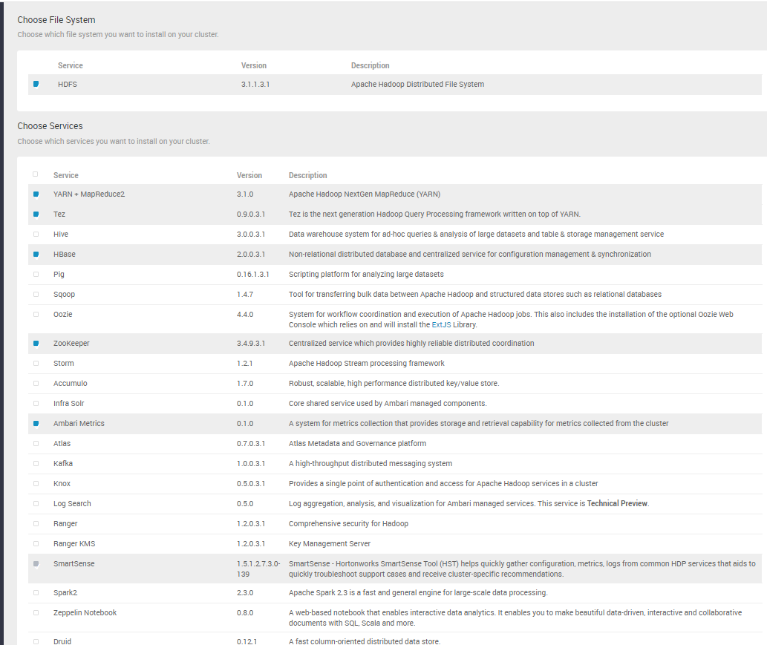
Ⅳ. Installing HDP
Choose Services
# HDFS, YARN+MapReduce2, Tez, HBase, Zookeeper, ambari-metrics 선택

Slide 19
Ⅳ. Installing HDP
Assign Masters
# (If it is a single node) Next click
# (Cluster-multinode)
- Namenode – n1 (or m1)
- Snamenode – n2 (or m2)
- Timeline Service – mo (or server with m3, ambari installed)
- ResourceManager - mo (or server where m3, ambari is installed)
- YARN Resgtry DNS - mo (or server where m3 and ambari are installed)
- History Server - mo (or server where m3, ambari is installed)
- Hbase Master – m1, m2, m3 (added by pressing + button)
- Grafana - mo (or server with m3, ambari installed)
- Activity Expolorer - mo (or server where m3 and ambari are installed)
- HST Server - mo (or server with m3, ambari installed)
- Activity Analyzer - mo (or server with m3, ambari installed)

Slide 20
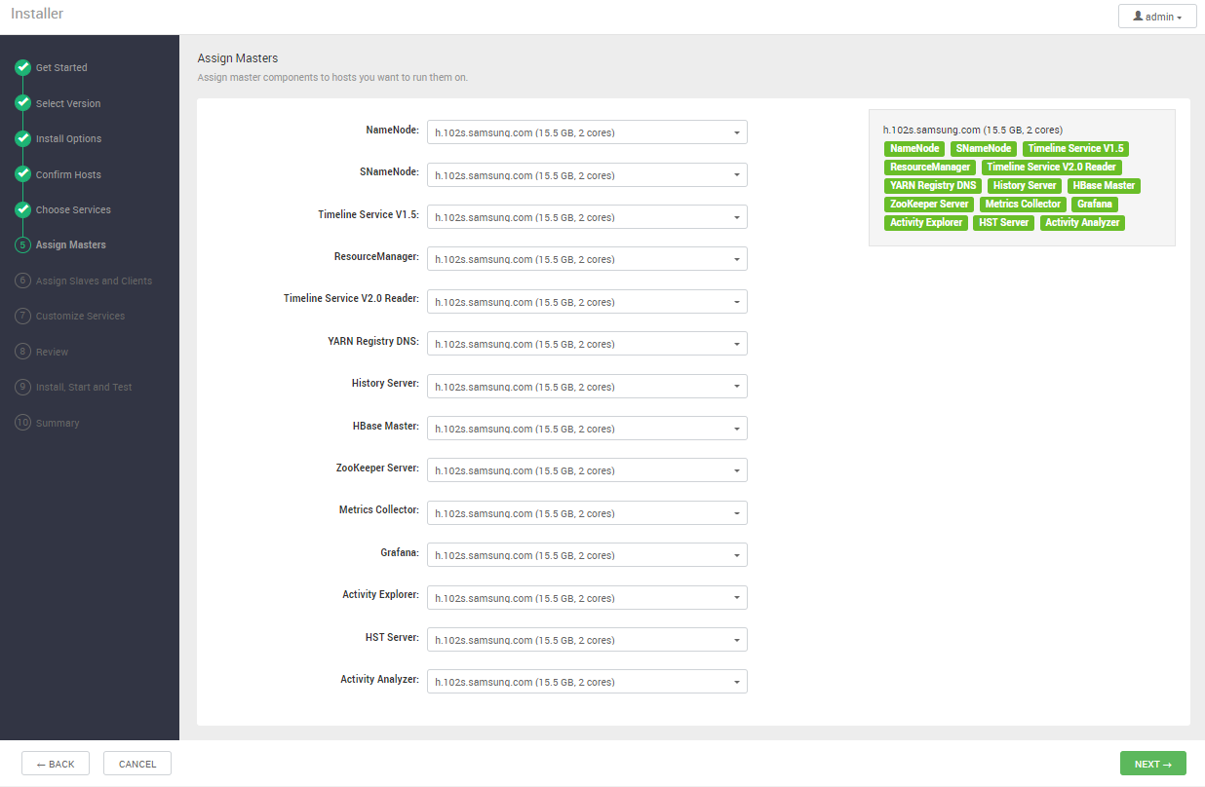
Ⅳ. Installing HDP
Assign Masters (Example of single node)
ip-10-4-61-31.ap-northeast-2.compute.internal
ip-10-4-61-31.ap-northeast-2.compute.internal
ip-10-4-61-31.ap-northeast-2.compute.internal
ip-10-4-61-31.ap-northeast-2.compute.internal
ip-10-4-61-31.ap-northeast-2.compute.internal
ip-10-4-61-31.ap-northeast-2.compute.internal
ip-10-4-61-31.ap-northeast-2.compute.internal
ip-10-4-61-31.ap-northeast-2.compute.internal
ip-10-4-61-31.ap-northeast-2.compute.internal
ip-10-4-61-31.ap-northeast-2.compute.internal
ip-10-4-61-31.ap-northeast-2.compute.internal
ip-10-4-61-31.ap-northeast-2.compute.internal
ip-10-4-61-31.ap-northeast-2.compute.internal
ip-10-4-61-31.ap-northeast-2.compute.internal

Slide 21
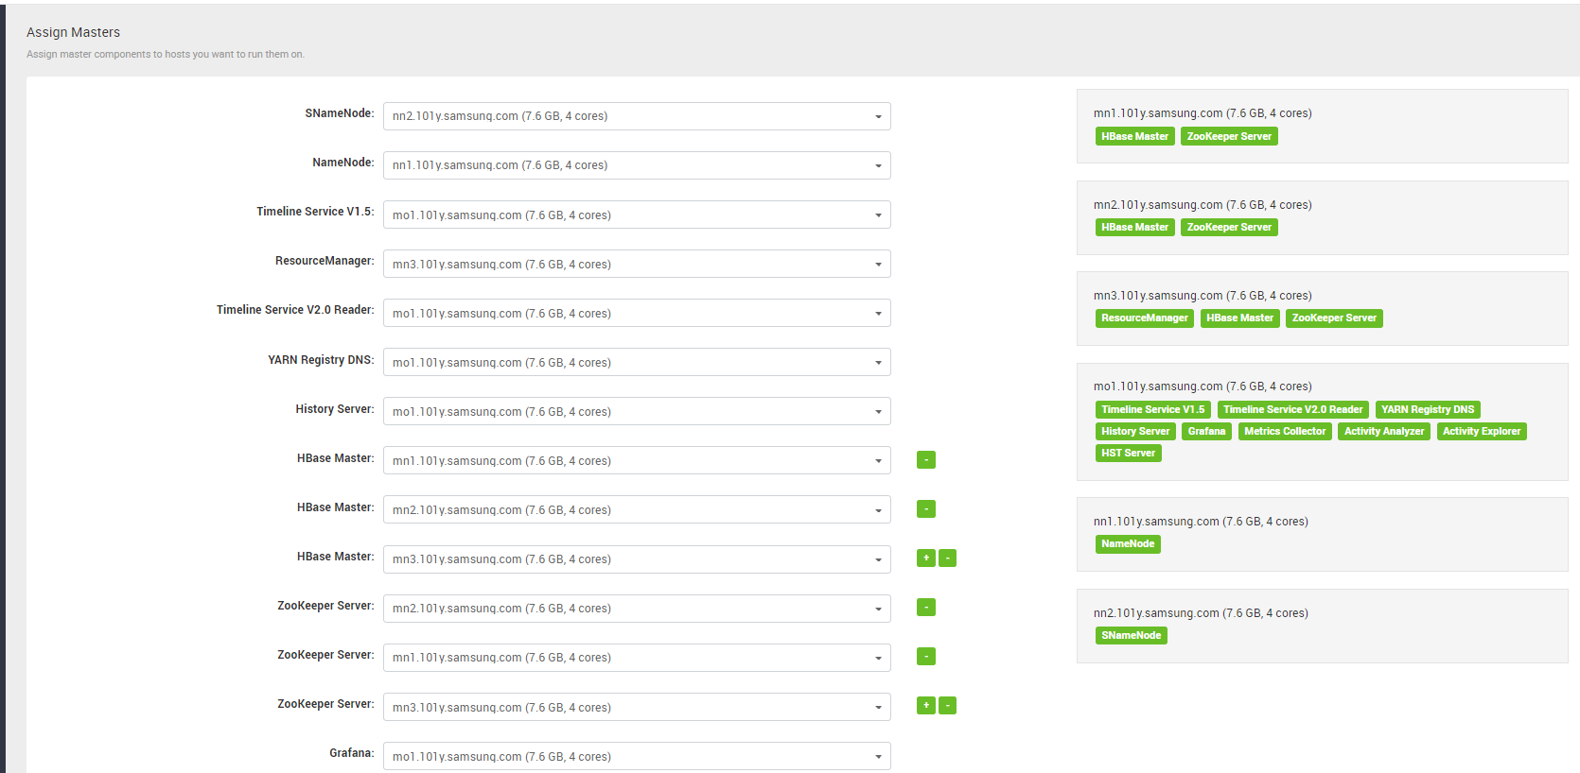
Ⅳ. Installing HDP
Assign Masters (Cluster structure example)

Slide 22
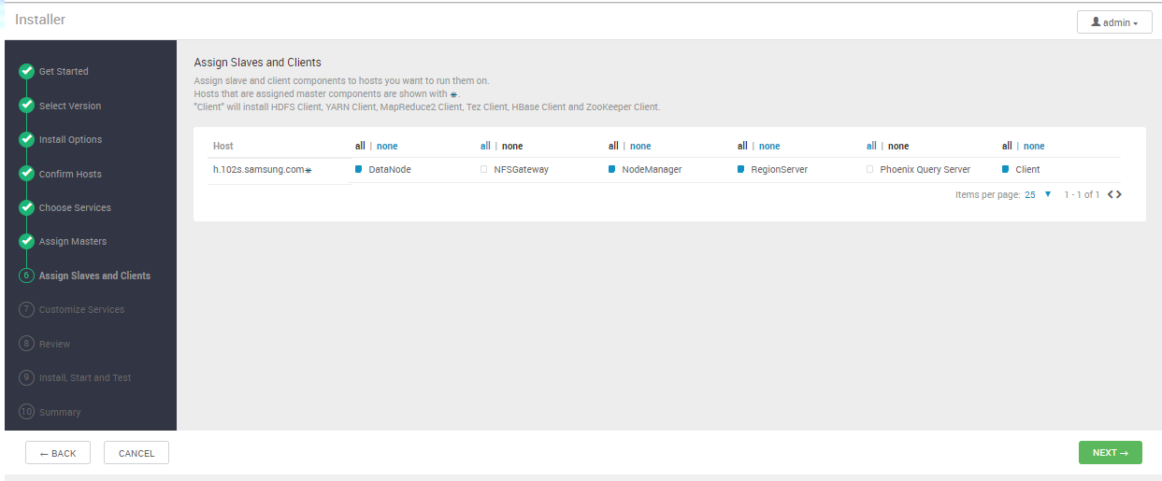
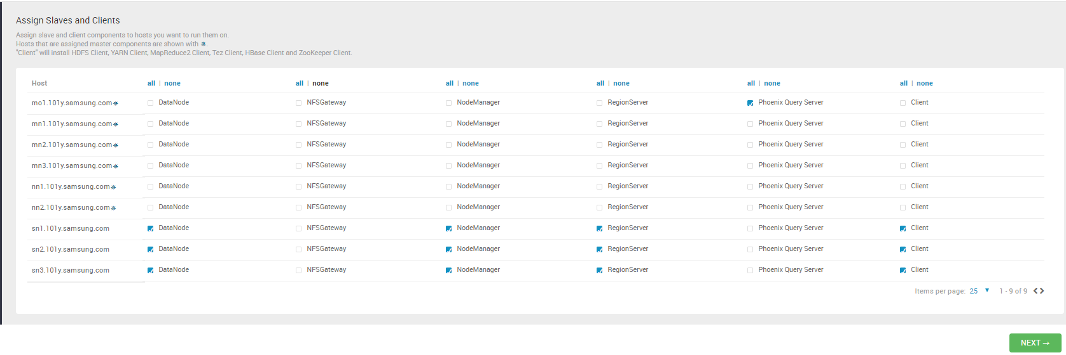
Ⅳ. Installing HDP
Assign Slaves and Clients
# (single node) Select DataNode, NodeManager, RegionServer, Client
# (Cluster) Select DataNode, NodeManager, RegionServer, and Client in s1 to s3 (sn server)
single node
ip-10-4-61-31.ap-northeast-2.compute.internal
Multinode (only sn or s server)

Slide 23
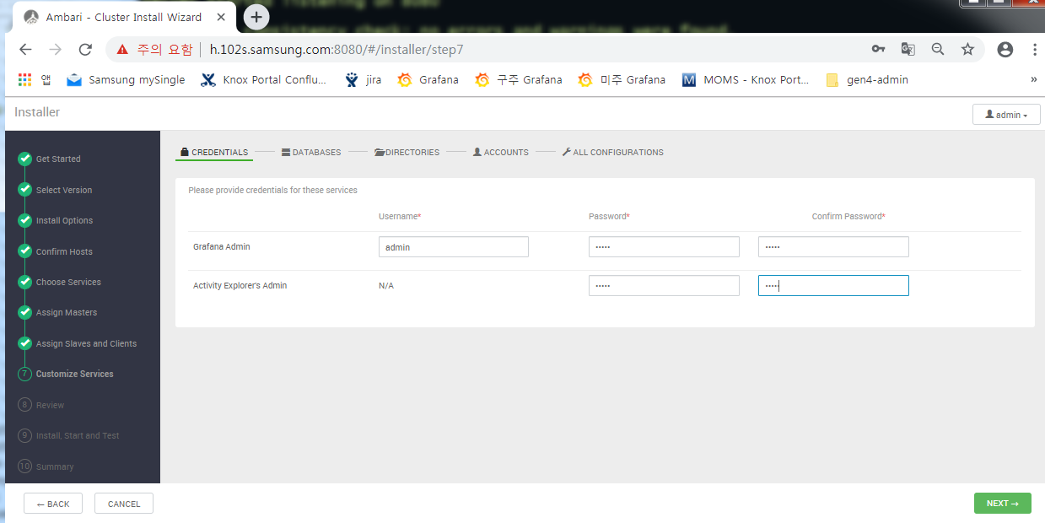
Ⅳ. Installing HDP
Customize Services
# Set account password of Grafana and Active Explorer Admin (to admin / admin)

Slide 24
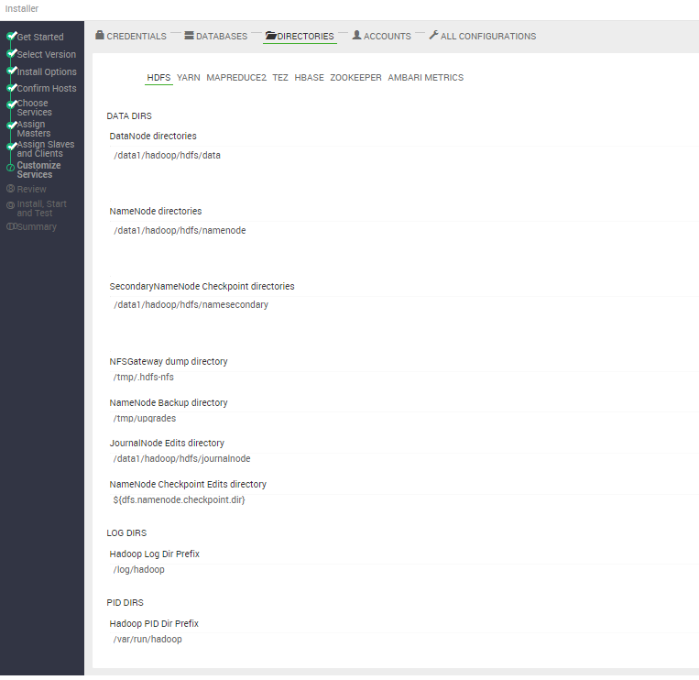
Ⅳ. Installing HDP
Customize Services
# Click on the top tab one by one and change the data director to / data1 bottom, and the log directory to / log bottom.
1) HDFS
DataNode directories : /data1/hadoop/hdfs/data
NameNode directories : /data1/hadoop/hdfs/namenode
SecondaryNameNode Checkpoint ~ : /data1/hadoop/hdfs/namesecondary
JournalNode Edits directory : /data1/hadoop/hdfs/journalnode
Hadoop Log Dir Prefix : /log/hadoop

Slide 25
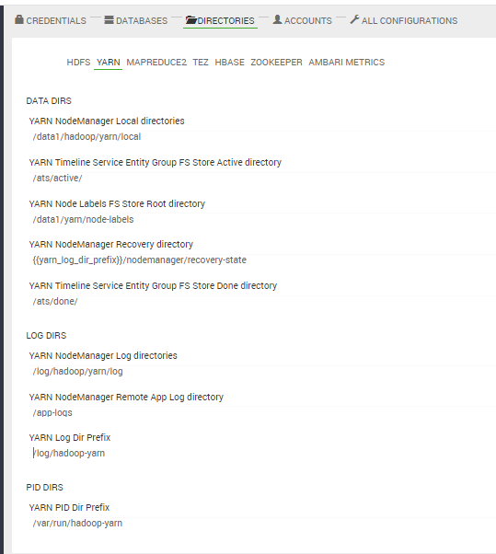
Ⅳ. Installing HDP
Customize Services
# Click on the top tab one by one and change the data director to / data1 bottom, and the log directory to / log bottom.
2) YARN
YARN NodeManager Local directories : /data1/hadoop/yarn/local
YARN Node Labels FS Store Root directories : /data1/yarn/node-labels
YARN NodeManager Log directories : /log/hadoop/yarn/log
YARN Log Dir Prefix : /log/hadoop

Slide 26
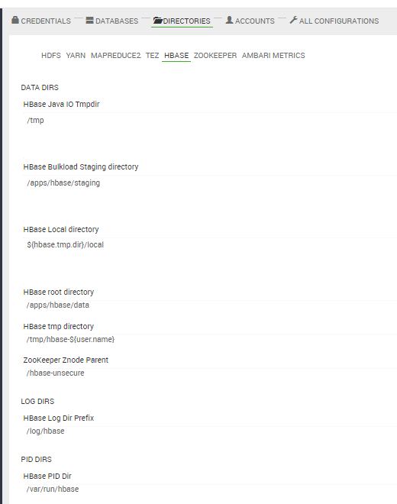
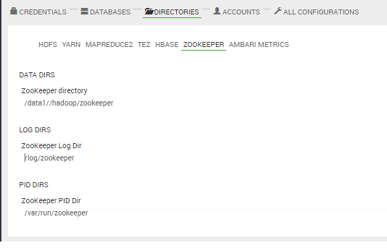
Ⅳ. Installing HDP
Customize Services
# Click on the top tab one by one and change the data director to / data1 bottom, and the log directory to / log bottom.
3) HBase
HBase Log Dir Prefix : /log/hbase
4) Zookeeper
Zookeeper directory : /data1/hadoop/zookeeper
Zookeeper Log Dir : /log/zookeeper

Slide 27
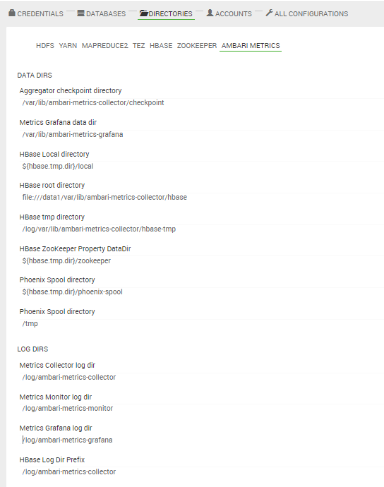
Ⅳ. Installing HDP
Customize Services
# Click on the top tab one by one and change the data director to / data1 bottom, and the log directory to / log bottom.
5) Ambari Metrics
Metrics Collector log dir : /log/ambari-metrics-collector
Metrics Monitor log dir : /log/ambari-metrics-monitor
Metrics Grafana log dir : /log/ambari-metrics-grafana
Hbase Log Dir Prefix : /log/ambari-metrics-collector
6) Click ALL CONFIGURATIONS at the top …
Next click at the bottom

Slide 28
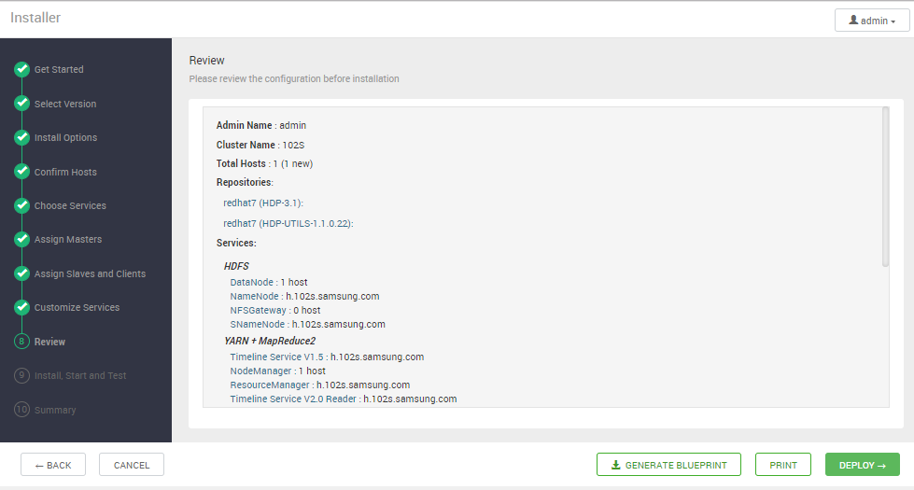
Ⅳ. Installing HDP
Review
# Final check whether the node configuration, Repo configuration, etc. are properly configured.
(In the case of the example below, the repositories are empty - it must be reset in Select Version
Or open a new window and reregister in http: / / {hostname}: 8080 / names / ADMIN _ VIEW / 2.7.3.0 / INSTANCE / # / stackVersions)
101C
http://public-repo-1.hortonworks.com/HDP/centos7/3.x/updates/3.1.0.0
http://public-repo-1.hortonworks.com/HDP-UTILS-1.1.0.22/repos/centos7
ip-10-4-61-31.ap-northeast-2.compute.internal
ip-10-4-61-31.ap-northeast-2.compute.internal
ip-10-4-61-31.ap-northeast-2.compute.internal
ip-10-4-61-31.ap-northeast-2.compute.internal
ip-10-4-61-31.ap-northeast-2.compute.internal
Notes:
http://h.201s.samsung.com:8080/views/ADMIN_VIEW/2.7.3.0/INSTANCE/#/stackVersions

Slide 29
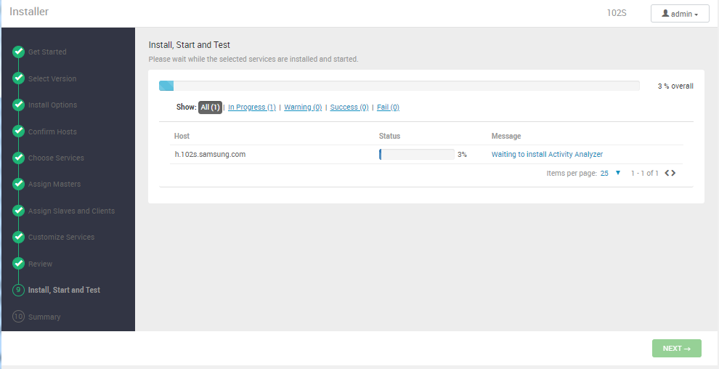
Ⅳ. Installing HDP
Install, Start and Test
# Click on the blue letter in the Message column to see the progress.
# When there is a problem, the message appears in red, and the next step is possible to solve the issue (trouble shooting from here)
ip-10-4-61-31.ap-northeast-2.compute.internal

Slide 30
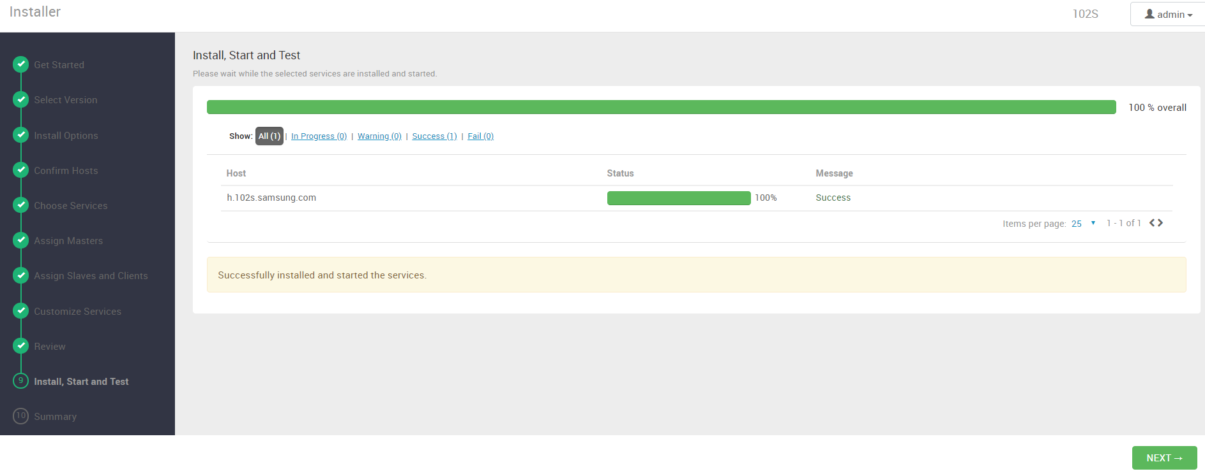
Ⅳ. Installing HDP
Install, Start and Test
# Installl is over!
ip-10-4-61-31.ap-northeast-2.compute.internal

Slide 31
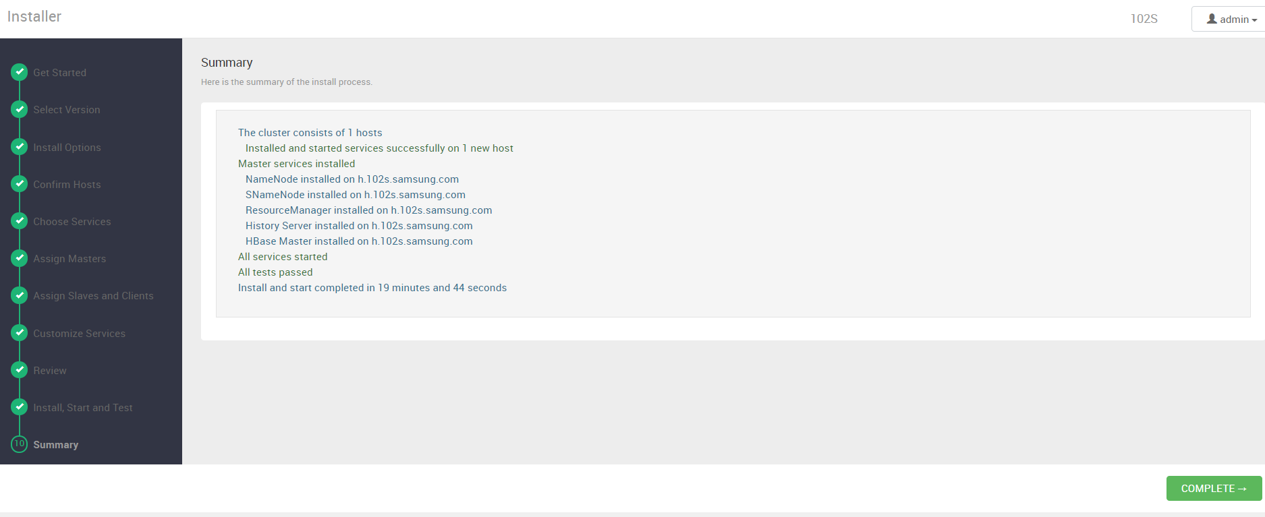
Ⅳ. Installing HDP
Summary
ip-10-4-61-31.ap-northeast-2.compute.internal
ip-10-4-61-31.ap-northeast-2.compute.internal
ip-10-4-61-31.ap-northeast-2.compute.internal
ip-10-4-61-31.ap-northeast-2.compute.internal
ip-10-4-61-31.ap-northeast-2.compute.internal

Slide 32
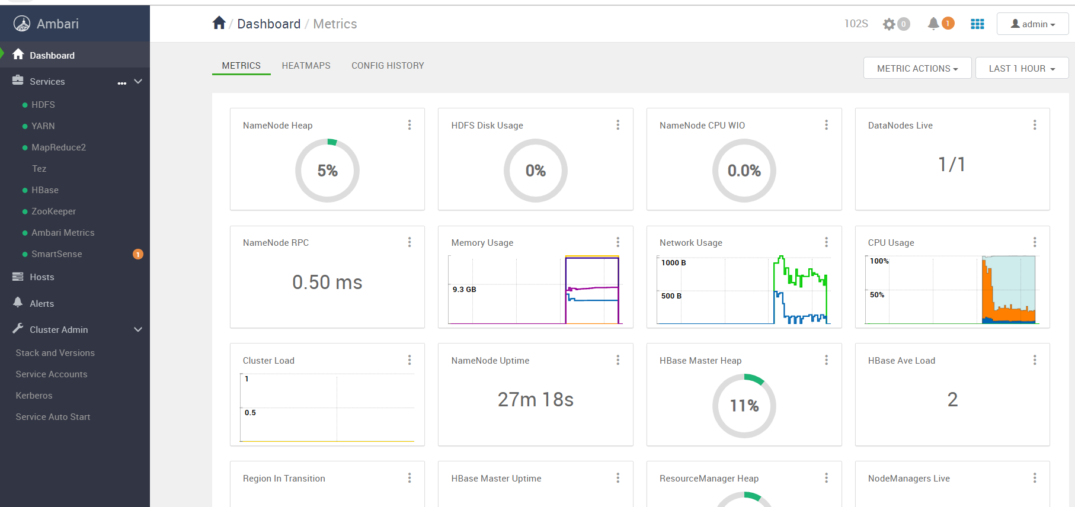
Ⅳ. Installing HDP
Installation complete
101C

Slide 33
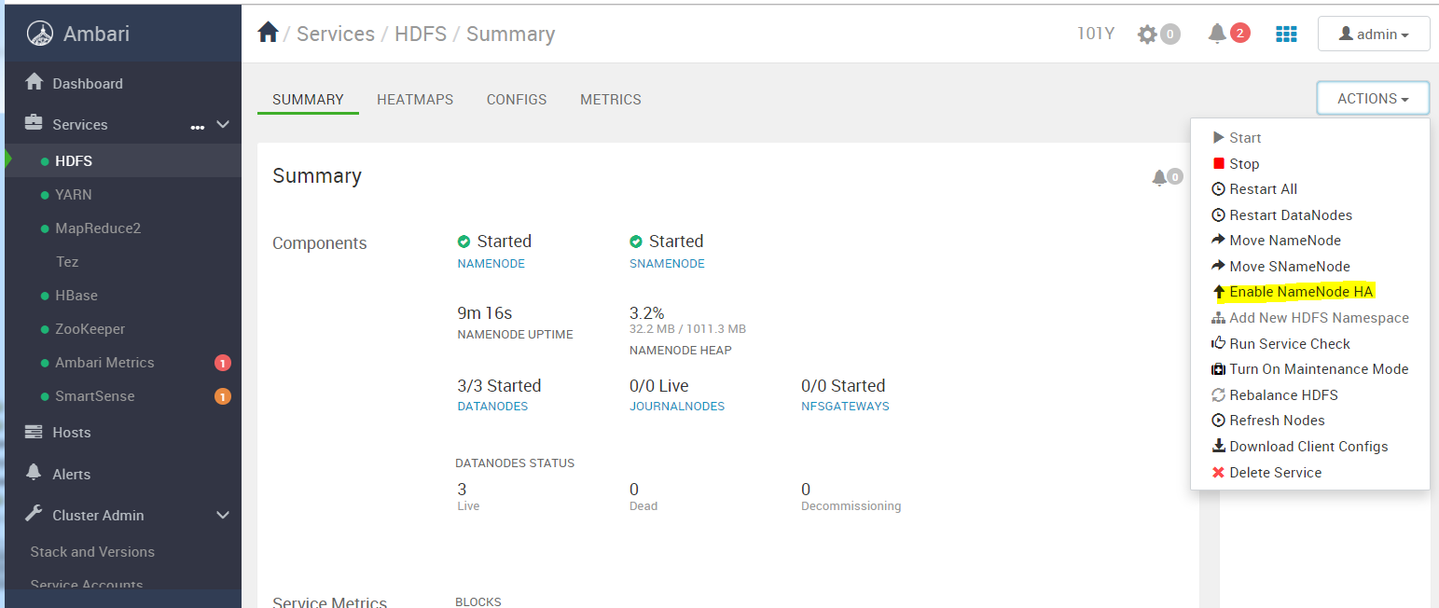
Ⅴ. After installation – Set NameNode HA
NameNode HA configuration (applicable only to multi-node)
# Services > Click HDFS and then click Actions > Enable NameNode HA in the upper right corner.

Slide 34
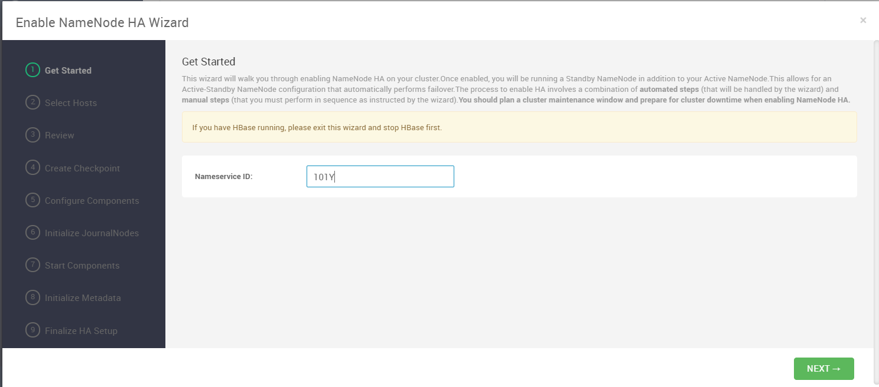
Ⅴ. After installation – Set NameNode HA
NameNode HA Configuration
NameNode HA configuration (applicable only to multi-node)
# Namesers` ID: Enter cluster name (101Y, etc.)

Slide 35
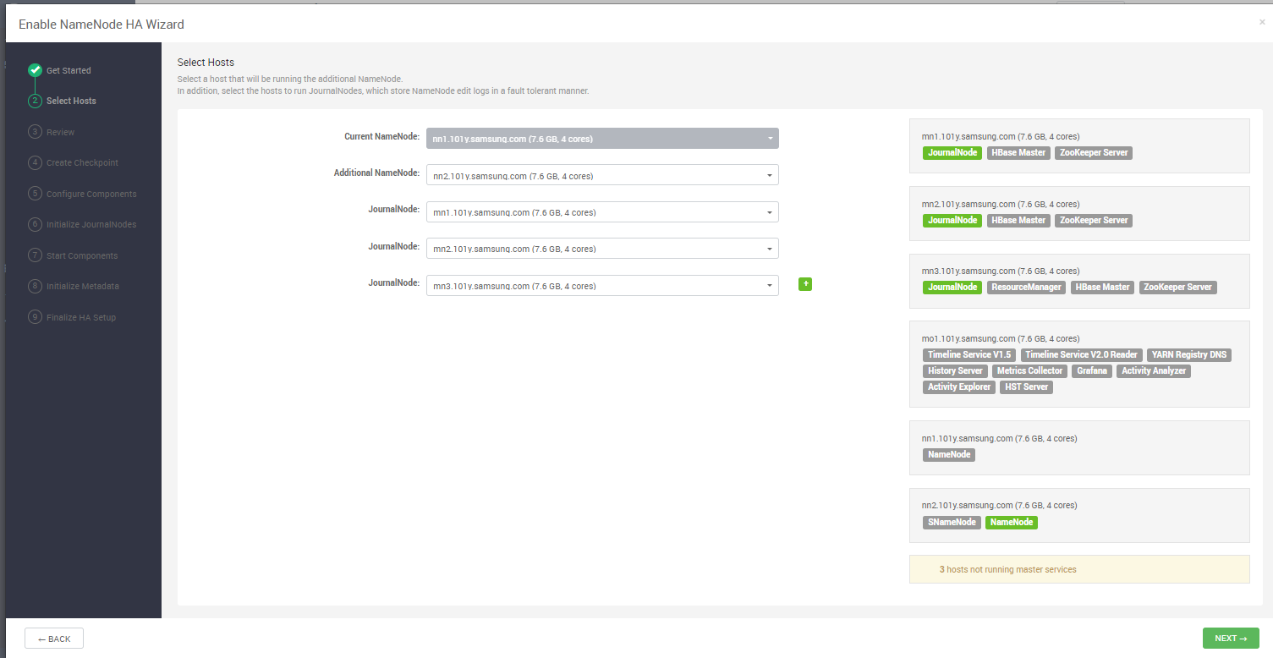
Ⅴ. After installation – Set NameNode HA
NameNode HA Configuration
NameNode HA configuration (applicable only to multi-node)
# Select nn2 server in Additional NameNode (or m2 server)
# JournalNode is mn1 ~ mn3 (or m1 ~ m3)

Slide 36
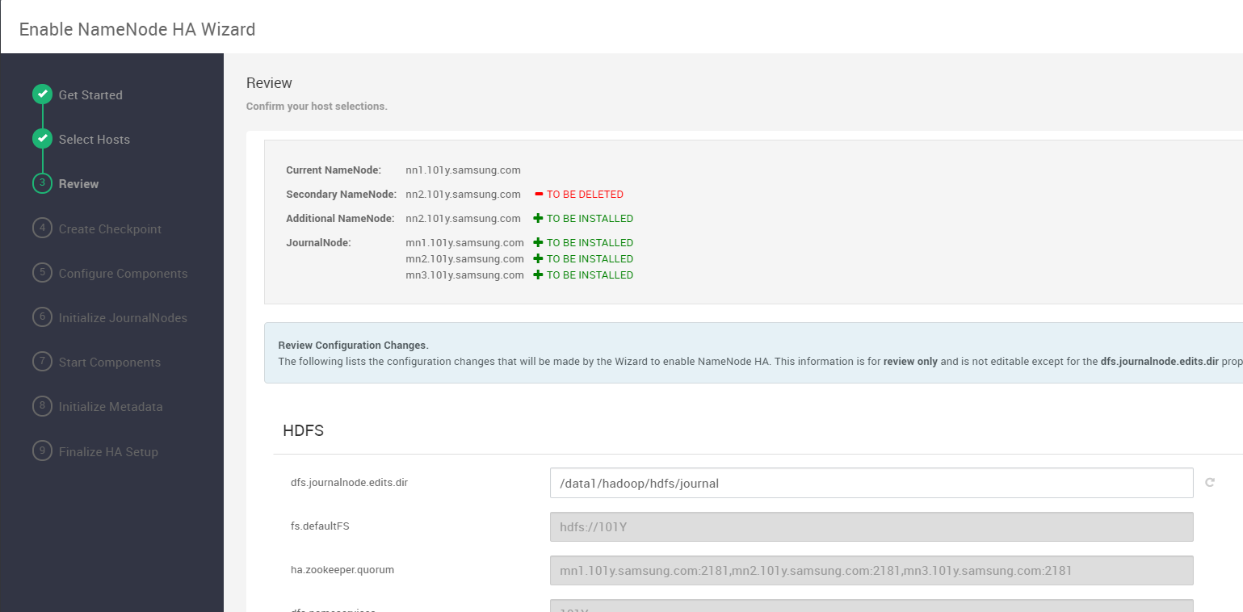
Ⅴ. After installation – Set NameNode HA
NameNode HA Configuration
NameNode HA configuration (applicable only to multi-node)
# dfs.journalnode.edits.dir 변경 : /data1/hadoop/hdfs/journal

Slide 37
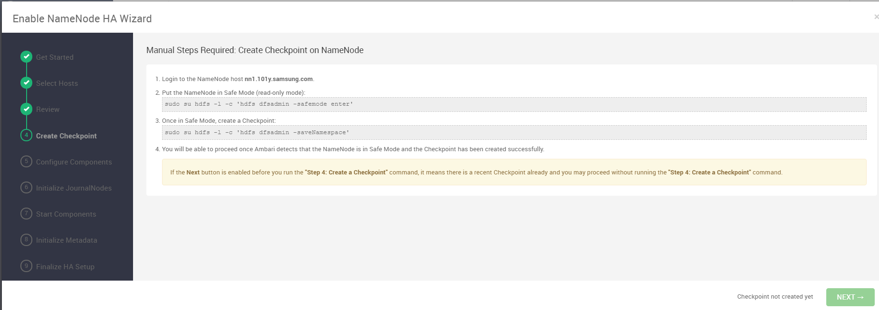
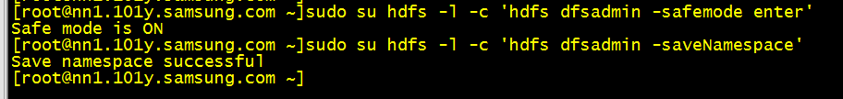
Ⅴ. After installation – Set NameNode HA
NameNode HA Configuration
NameNode HA configuration (applicable only to multi-node)
# Proceed as manual in the Web UI below
- Make sure to check the connecting host.
- Perform using root.

Slide 38
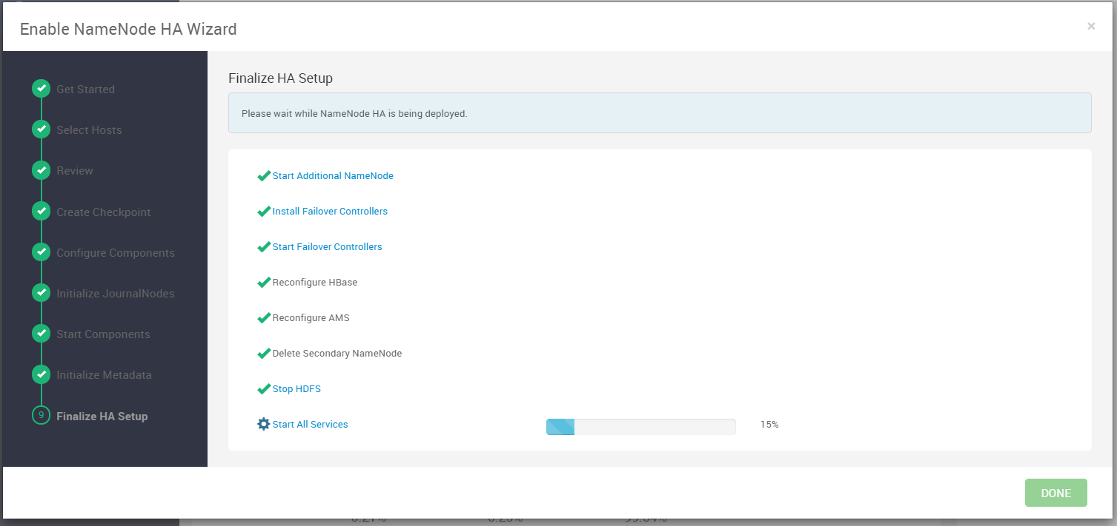
Ⅴ. After installation – Set NameNode HA
NameNode HA Configuration
NameNode HA configuration (applicable only to multi-node)
# After doing some steps in the middle as you want, the screen below

Slide 39
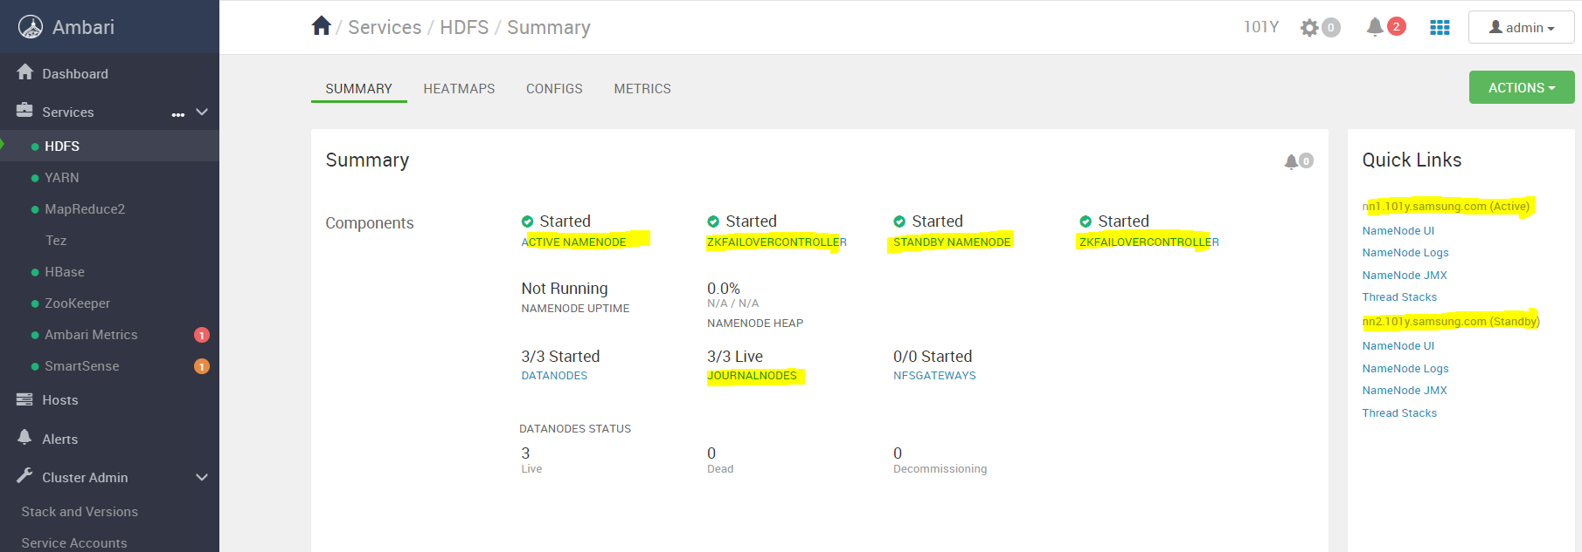
Ⅴ. After installation – Set NameNode HA
NameNode HA Configuration
NameNode HA configuration (applicable only to multi-node)
# Ambari > HDFS screen check Actvie Namenode, Statndby Namenode, ZFKC, JournalNode service status

Slide 40
Ⅴ. Work after installation – Escore Coprocessor and HGS distribution
Distribution of Escore Coprocessor and HGS
1. Distributing coprocessor and lib, hbase.reposo
- Access to all nodes (root)
- Jumphost server 52.78.166.23 / data1 / epsvc / mail / new _ 101c / file / hbase Copy jar files below / usr / hdp / 3.1.0.0-78 / hbase / lib
Copy / usr / hdp / 3.1.0.0-78 / hbase / bin
2. Create HGS Activation Script
- Access the node to float HGS (hbase account)
- mkdir /home/hbase/thrift
- echo “/usr/hdp/3.1.0.0-78/hbase/bin/hbase-daemon.sh start scorethrift –p 9090 –to 0 –sc 1000 –nw 1000 –xw 5000 –sp 1 –xc 2000” > /home/hbase/thrift/start_thrift.sh
- echo “/usr/hdp/3.1.0.0-78/hbase/bin/hbase-daemon.sh stop scorethrift” > /home/hbase/thrift/stop_thrift.sh
- chmod 744 /home/hbase/thrift/*.sh
- / log / hbase (created with root if not)

Slide 41
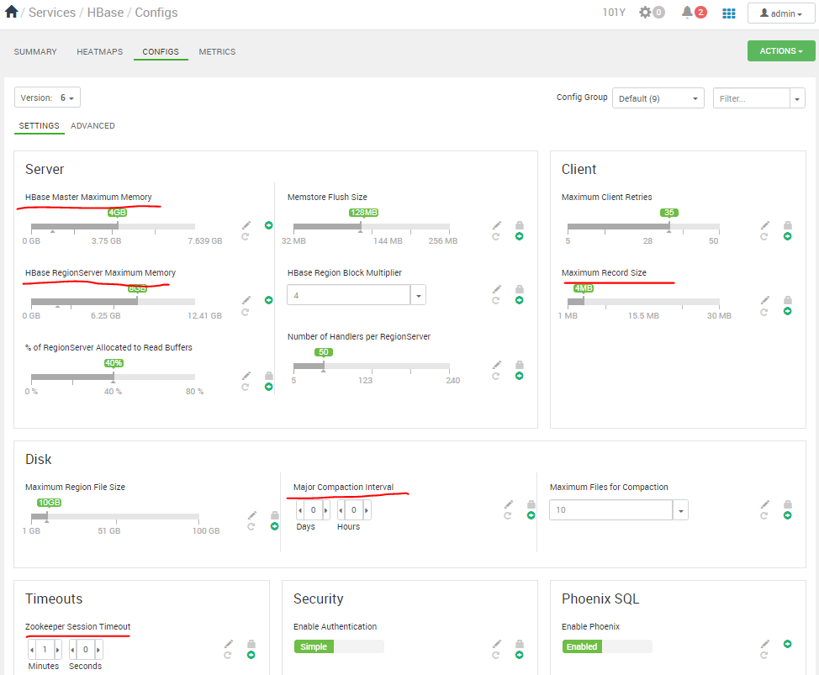
Ⅴ. After installation – Set HBase Config
Setting HBase Config (including Escore Custom Config)
Ambari > Hbase > Configs > Settings
<Server>
HBase master maximum memory: 1 / 2 level
HBase RegionServer Maximum Memory: 2 / 3 level
<Client>
Maximum Record Size : 4mb
<Disk>
Major Compaction Interval : 0
<Timeouts>
zookeeper session timeout : 1분

Slide 42
Ⅴ. After installation – Set HBase Config
Setting HBase Config (including Escore Custom Config)
Ambari > Hbase > Configs > Advanced
< advanced hbase-env >
- hbase-env template: Added the following contents
## 2017.06.18 THRIFT GC tuning.. by bw.park
export HBASE_HGS_GC_OPTS="-Xms4096m -Xmx4096m -XX:NewRatio=2 -XX:SurvivorRatio=4 -XX:-UseAdaptiveSizePolicy -XX:MaxTenuringThreshold=8 -XX:+UseParNewGC -XX:+CMSParallelRemarkEnabled -XX:MetaSpaceSize=64m -XX:CMSInitiatingOccupancyFraction=25 -XX:+UseCMSInitiatingOccupancyOnly"
export HBASE_THRIFT_OPTS="$HBASE_THRIFT_OPTS $HBASE_JMX_OPTS -Dcom.sun.management.jmxremote.port=10103 -Dcom.sun.management.jmxremote.authenticate=false $HBASE_HGS_GC_OPTS $HBASE_HEAPDUMP_OPTS"
< advanced hbase-log4j >
- Added the following contents
# score thrift
##2015.6.20 change com to net
log4j.appender.scorethrift=net.samsung.smail.hbase.thrift.util.DailyMaxRollingFileAppender
log4j.appender.scorethrift.File=${hbase.log.dir}/${hbase.log.file}
log4j.appender.scorethrift.DatePattern='.'yyyyMMddHH
log4j.appender.scorethrift.MaxBackupIndex=30
log4j.appender.scorethrift.layout=org.apache.log4j.PatternLayout
log4j.appender.scorethrift.layout.ConversionPattern=%d{ISO8601} %-5p [%t] %m%n
# HGS logging information (2015.6.20 add)
log4j.logger.net.samsung.smail.hbase=INFO
# DAL COPROCESSOR
log4j.logger.net.samsung.smail.dal=INFO

Slide 43
Ⅴ. After installation – Set HBase Config
Setting HBase Config (including Escore Custom Config)
< advanced hbase-site >
hbase.coprocessor.master.classes : org.apache.hadoop.hbase.security.access.AccessController,net.samsung.smail.dal.colocation.master.RegionColocationMasterObserver
hbase.coprocessor.region.classes : org.apache.hadoop.hbase.coprocessor.AggregateImplementation,org.apache.hadoop.hbase.security.access.AccessController,org.apache.hadoop.hbase.coprocessor.example.RowCountEndpoint,org.apache.hadoop.hbase.security.access.SecureBulkLoadEndpoint
< custom hbase-site >
Add property click > bulk property add mode selection
hbase.increasing.policy.initial.size=10737418240
hbase.ipc.warn.responsetime=1000
hbase.lease.recovery.timeout=300000
hbase.master.loadbalance.bytable=TRUE
hbase.master.loadbalancer.class=net.samsung.smail.dal.colocation.loadbalancer.RegionColocationLoadBalancer
hbase.region.colocation.tableinfo=[{"primary":"MML_tMail", "splitCascading":false, "secondaries":["MML_iMailIndex", "MML_tFolder", "MME_tCheckRcv", "MME_tFileRef"]}]
hbase.regionserver.global.memstore.lowerLimit=0.28
hbase.regionserver.global.memstore.upperLimit=0.3
hbase.regionserver.region.split.policy=org.apache.hadoop.hbase.regionserver.ConstantSizeRegionSplitPolicy
hbase.replication=TRUE
hbase.rs.cacheblocksonwrite=TRUE
index.operation.retry.max=3

Slide 44
Ⅴ. After installation – HBase restart and HGS operation
HBase restart and HGS operation
# Ambari > Hbase > Actions > Stop , Start
# HGS operation
/home/hbase/thrift/start_thrift.sh
tail -f /log/hbase/*score*.log

Slide 45
Ⅴ. Work after installation – Create Hbase table
HBase Table Creation 2 (Recommendation)
Utilizing the creation script provided by # S-Core
# Stage jumphost gw server (52.78.166.23)
/ data1 / epsvc / mail / new _ 101c / file / hbase _ install Copy the schema.tar folder below to the Ambari server.
schema.tar decompression
# Run m _ init _ tables.sh at the bottom of each directory (with hbase account)
Notes:
[Create as a script]
hbase@s1.101b.ss.com:/home/hbase/schema/smail-bms> ./m_init_queue_tables.sh
Schema version : 0.1.0.0
Initializing tables....
hbase@s1.101b.ss.com:/home/hbase> hbase shell
Error: Could not find or load main class org.jruby.Main
[root@s1.101b.ss.com /usr/hdp/2.6.4.0-91/hbase/lib/ruby]mv jruby-complete-1.6.8.jar ../
hbase@s1.101b.ss.com:/home/hbase/schema/smail-bms> ./m_init_queue_tables.sh
Schema version : 0.1.0.0
Initializing tables....
Creating MMQ_tBms...
Creating MMQ_tQueue...
Creating MMQ_tMsg...
Initializing tables done.
hbase@s1.101b.ss.com:/home/hbase/schema/smail-irhr> ./m_init_irhr_table.sh
Schema version : 0.1.0.0
Initializing tables....
Creating MME_tIrhrChk...
Initializing tables done.
hbase@s1.101b.ss.com:/home/hbase/schema/smail-dal> ./m_init_tables.sh –m
hbase@s1.101b.ss.com:/home/hbase/schema/smail-dal> ./m_init_tables.sh -m
config_dir=/home/hbase/schema/smail-dal
Schema version : 2.0.0
Initializing tables....
Creating MME_tMeta...
Schema metadata initializing...
metadata initializing for MME_tAutoRsps from /home/hbase/schema/smail-dal/MME_tAutoRsps.config
metadata initializing for MME_tCheckRcv from /home/hbase/schema/smail-dal/MME_tCheckRcv.config
metadata initializing for MME_tFileRef from /home/hbase/schema/smail-dal/MME_tFileRef.config
metadata initializing for MME_tSchd from /home/hbase/schema/smail-dal/MME_tSchd.config
metadata initializing for MME_tSchWork from /home/hbase/schema/smail-dal/MME_tSchWork.config
metadata initializing for MML_tDlExpandedList from /home/hbase/schema/smail-dal/MML_tDlExpandedList.config
metadata initializing for MML_tDlMapping from /home/hbase/schema/smail-dal/MML_tDlMapping.config
metadata initializing for MML_tDlSummary from /home/hbase/schema/smail-dal/MML_tDlSummary.config
metadata initializing for MML_tFolder from /home/hbase/schema/smail-dal/MML_tFolder.config
metadata initializing for MML_tMail from /home/hbase/schema/smail-dal/MML_tMail.config
Creating MML_tFolder...
Creating MML_tMail...
Registering Coprocessors to MML_tMail....
Creating MML_iMailIndex...
Registering Coprocessors to MML_iMailIndex....
Creating MME_tAutoRsps...
Creating MME_tCheckRcv...
Creating MME_tSchd...
Creating MME_tSchWork...
Creating MME_tFileRef...
Creating MML_tDlSummary...
Creating ...
Creating MML_tDlMapping...
Initializing tables done.

Slide 46
Ⅴ. Work after installation - Set Hbase table
table compression configuration
# hbase shell
alter 'MML_tMail', {NAME=>'d', COMPRESSION=>'SNAPPY'}
alter 'MML_iMailIndex',{NAME=>'d', COMPRESSION=>'SNAPPY'}
alter 'MME_tCheckRcv', {NAME=>'d', COMPRESSION=>'SNAPPY'}
alter 'MME_tFileRef', {NAME=>'d', COMPRESSION=>'SNAPPY'}
alter 'MME_tIrhrChk', {NAME=>'h', COMPRESSION=>'SNAPPY'}
alter 'MME_tSpamReport', {NAME=>'d', COMPRESSION=>'SNAPPY'}
alter 'MML_tDlMapping', {NAME=>'d', COMPRESSION=>'SNAPPY'}
alter 'MML_tDlSummary', {NAME=>'d', COMPRESSION=>'SNAPPY'}
alter 'MML_tDlExpandedList', {NAME=>'d', COMPRESSION=>'SNAPPY'}
Coprocessor Configuration
# hbase shell
alter 'MML_iMailIndex','coprocessor'=> '|net.samsung.smail.dal.index.coprocessor.region.scanner.IndexScanner|1001|'
alter 'MML_tMail','coprocessor'=> '|net.samsung.smail.dal.index.coprocessor.region.Indexer|1001|'
alter 'MML_tMail', "coprocessor" => "|org.apache.hadoop.hbase.regionserver.RegionSplitter|1002|"
Notes:
You can check what table is in the list
Check Scan ‘ Table Name ’ data
Check table settings with Describe ‘ Table Name ’.
hbase(main):052:0* describe 'MML_iMailIndex'
Table MML_iMailIndex is ENABLED
MML_iMailIndex, {TABLE_ATTRIBUTES => {coprocessor$1 => '|net.samsung.smail.dal.index.coprocessor.region.scanner.IndexScanner|1001|'}
COLUMN FAMILIES DESCRIPTION
{NAME => 'd', VERSIONS => '1', EVICT_BLOCKS_ON_CLOSE => 'false', NEW_VERSION_BEHAVIOR => 'false', KEEP_DELETED_CELLS => 'FALSE', CACHE_DATA_ON_WRITE => 'false', DATA_BLOCK_ENCODING => 'NONE', TTL => 'FOREVER', MIN_VERSIONS => '0', REPLICATION_SCOPE => '0',
BLOOMFILTER => 'ROW', CACHE_INDEX_ON_WRITE => 'false', IN_MEMORY => 'false', CACHE_BLOOMS_ON_WRITE => 'false', PREFETCH_BLOCKS_ON_OPEN => 'false', COMPRESSION => 'SNAPPY', BLOCKCACHE => 'true', BLOCKSIZE => '65536'}
1 row(s)
Took 0.0154 seconds

